Slide 1
Endofotonics
Lipidomics Analysis Report V1.2 SingMass / 12 March 2023

Slide 2
Table of Contents
EXPLORATORY DATA ANALYSIS
Sample Clustering
PCA analysis
Statistical Comparisons
Significanlty different lipid species
Dot/box plots of all species

Slide 3
EXPLORATORY DATA ANALYSIS

Slide 4
Sample Clustering
Figure 1. Heatmap with clustering of samples. Dendrogram is based on hierarchical clustering of Euclidean distances of z-scored lipid concentrations using complete linkage. Lipid species were ordered by alphabetical order. For the heatmap, colors corresponds to z-scored (per row) concentration values.

Slide 5
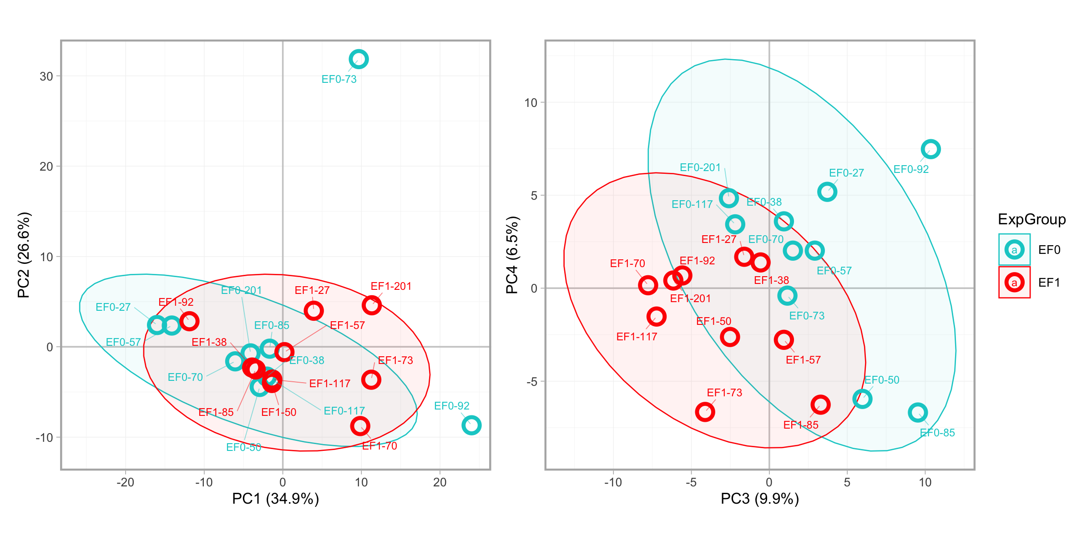
PCA analysis
Figure 2. Principal component analysis (PCA) of all samples based on all lipid species. PCA is based on standardized and centered (z-scored) concentration data of all measured lipid species and samples. Shaded ellipses are correspond to 95% confidence ranges for each group.

Slide 6
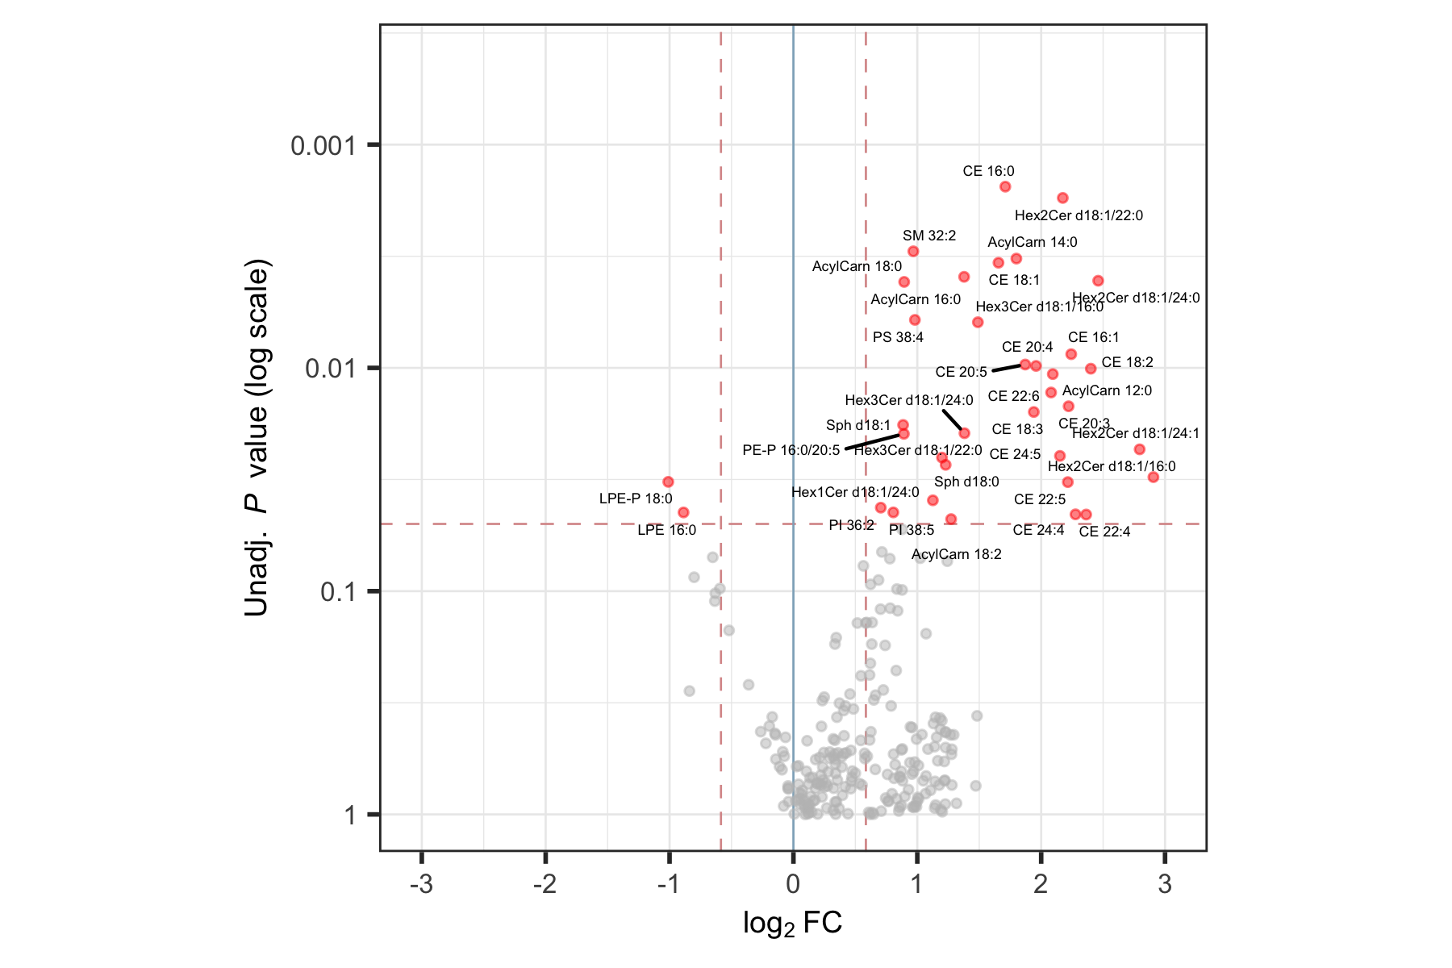
Statistical Comparisons
Figure 3. Volcano plots obtained from the statistical comparison of the experimental groups. Unadjusted P values were obtained from paired t-tests using lipid concentrations. Log2FC corresponds to the log2 of the fold-changes between the group means of the EF1 and EF0 experimental groups. Positive log2FC indicates concentrations are higher in the EF1 group compared to the reference group (EF0). Lipid species with P < 0.05 and |FC| > 1.5 ( = |log2FC| > 0.585) are highlighted in red.

Slide 7
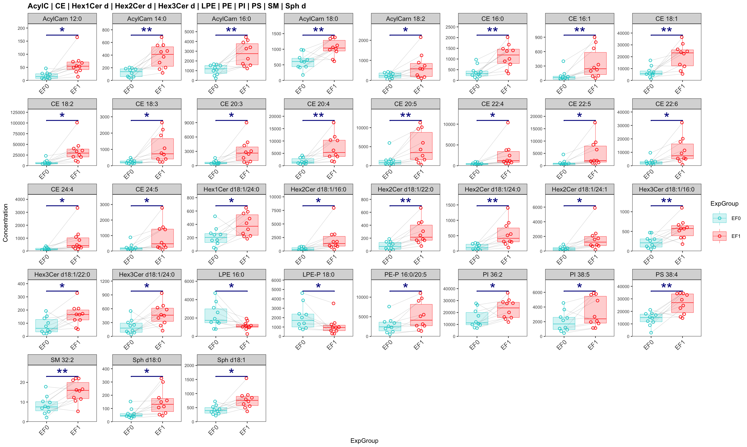
Significanlty different lipid species
Figure 4. Lipid species with statistically significant changes as highlighted in Figure 3. Only lipid species with P < 0.05 and |FC| > 1.5 from the comparisons EF1 vs EF0. Statistical significances correspond to the results of paired t-tests on concentration data. Only significant comparisons (P < 0.05) indicated: * < 0.05, ** < 0.01, *** < 0.001. Concentration corresponds to pmol/mg protein.
## [[1]]

Slide 8
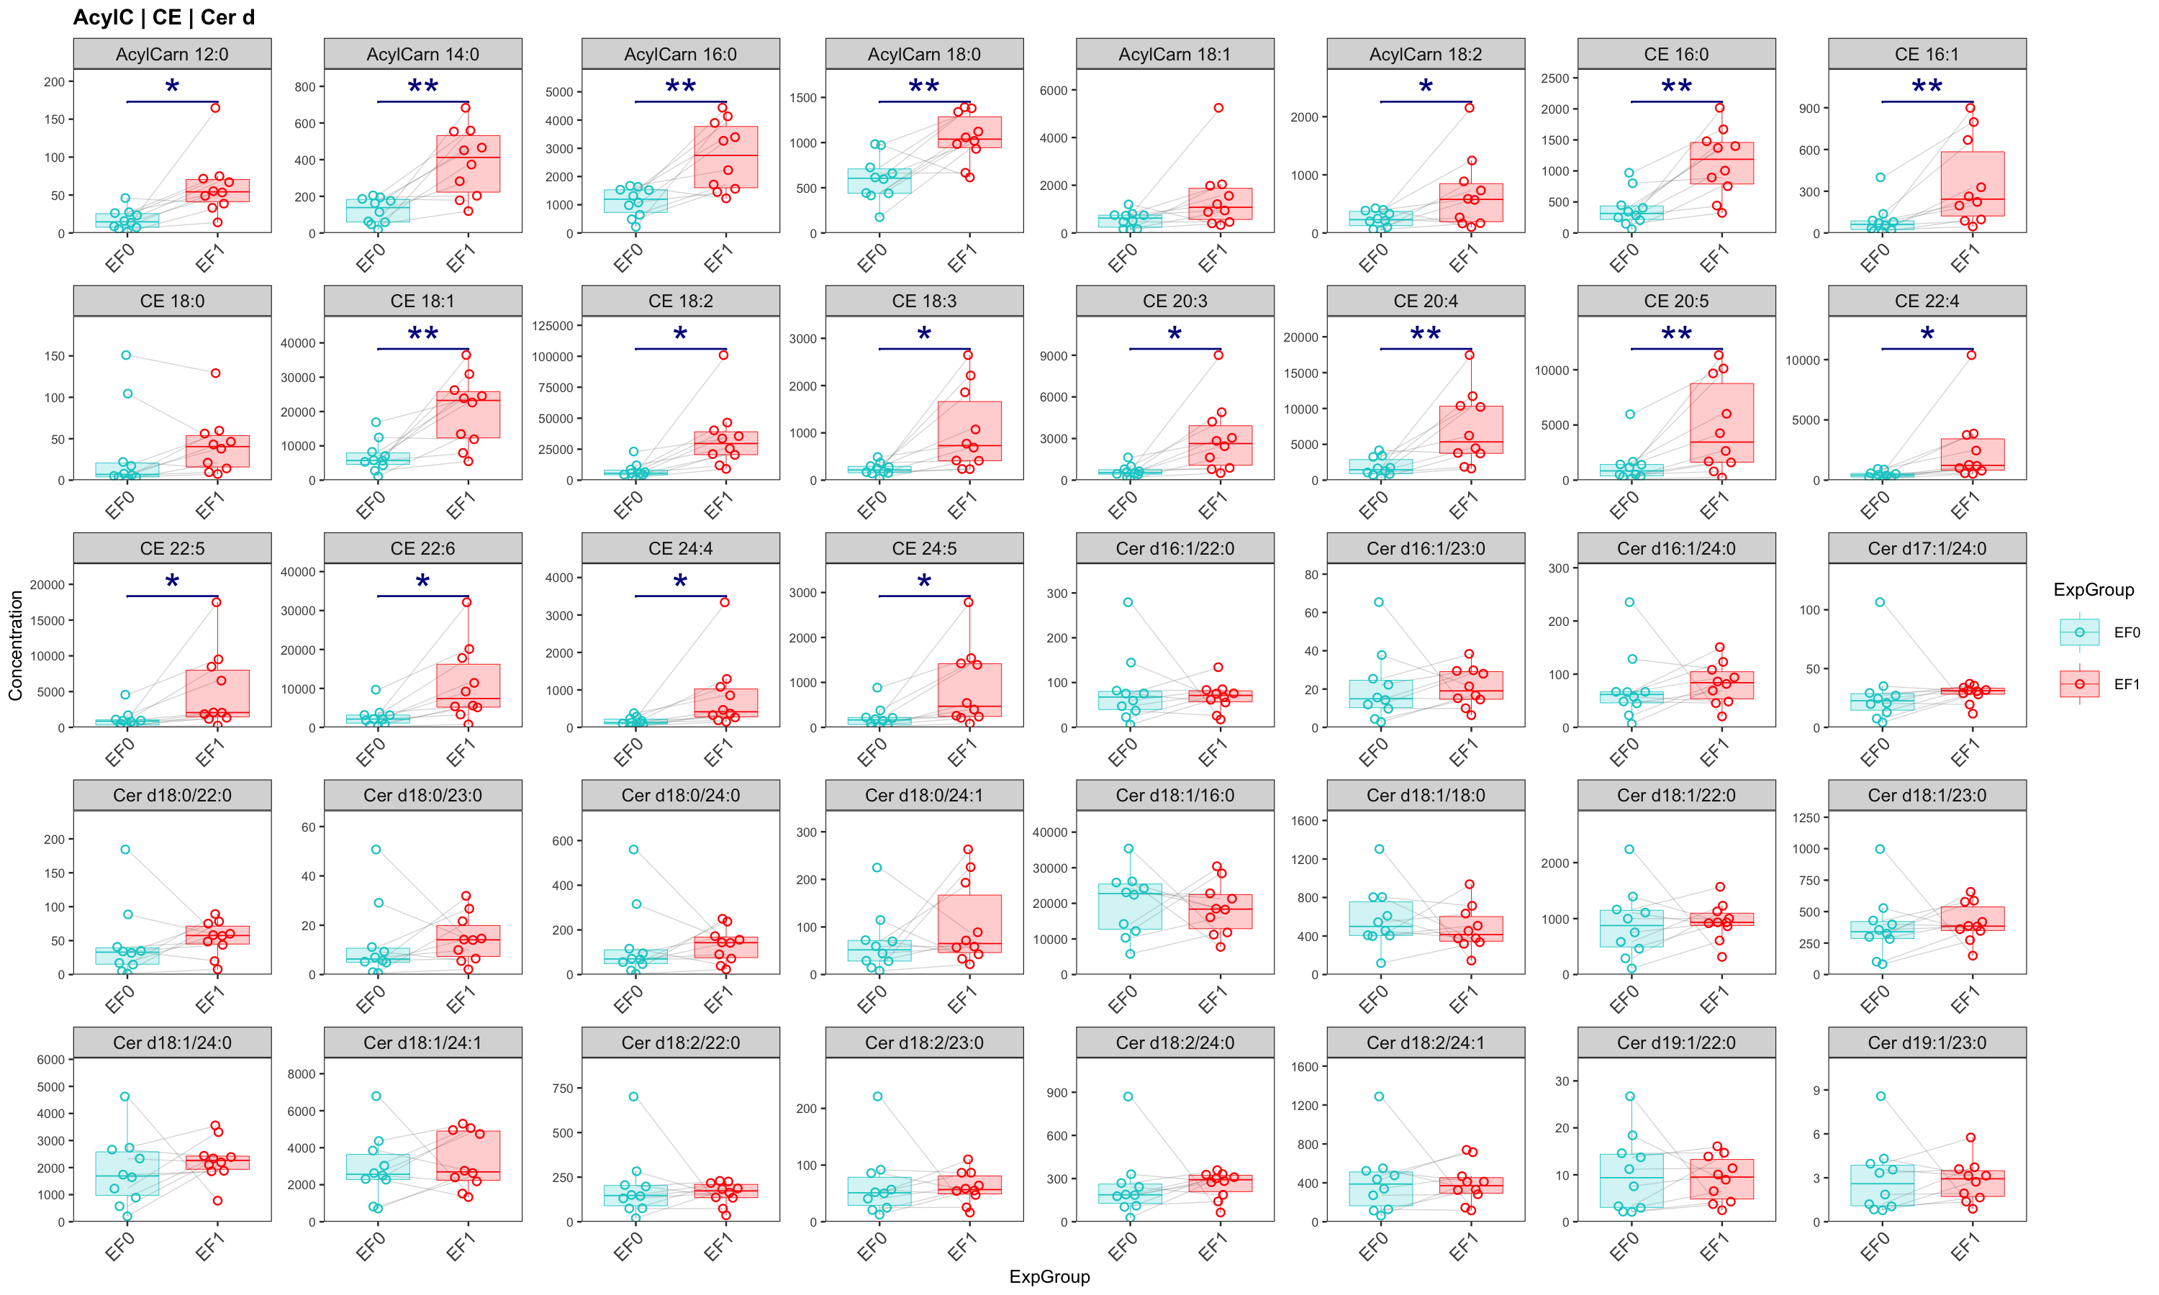
Dot/box plots of all species
Figure 5. Dot and box plots of all quantified lipid species. Statistical significances correspond to the result of paired t-test on concentration data. Only significant comparisons (P < 0.05) indicated: * < 0.05, ** < 0.01, *** < 0.001. Concentration corresponds to pmol/mg protein.
## [[1]]

Slide 9
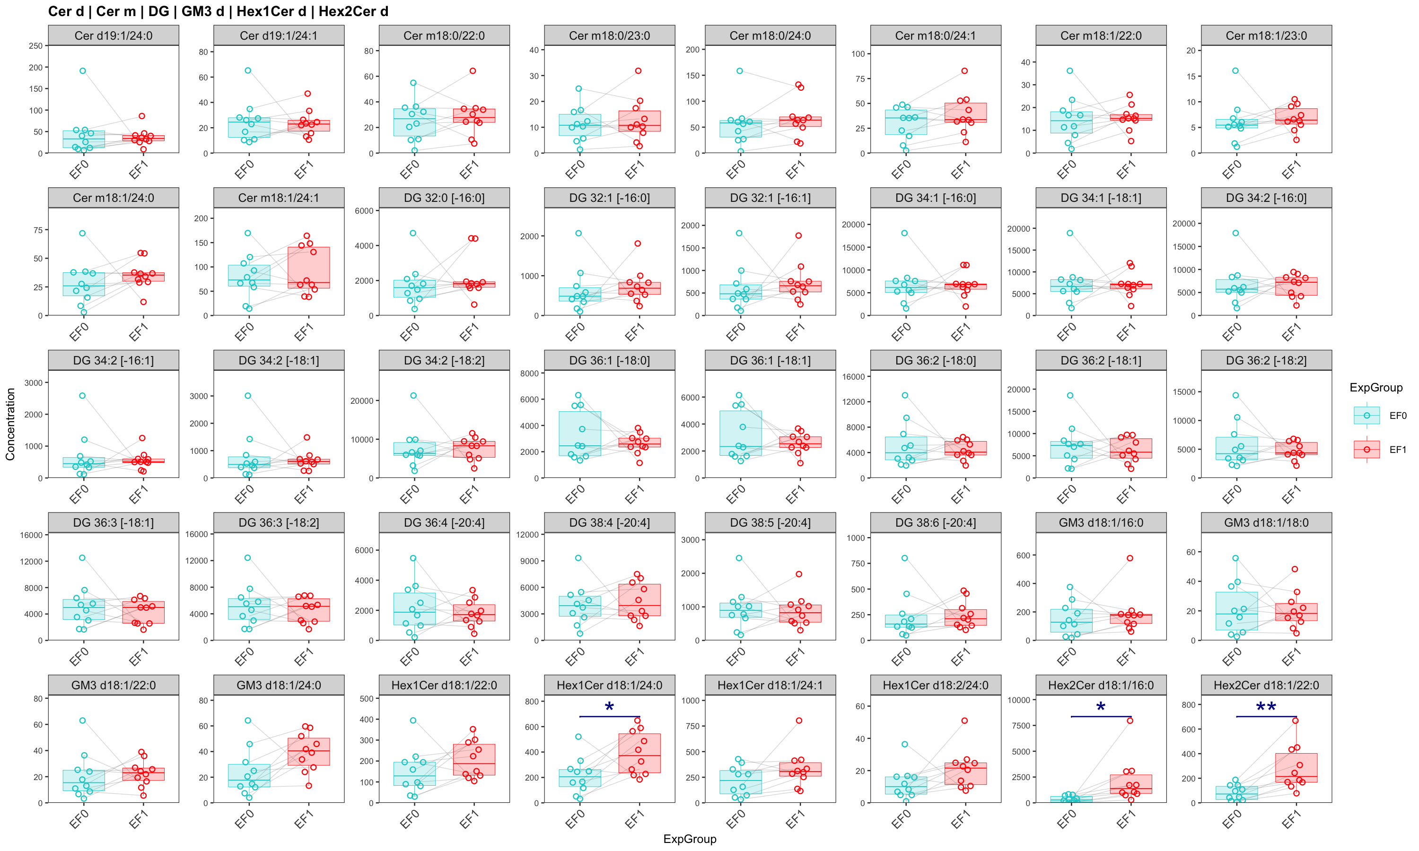
## ## [[2]]

Slide 10
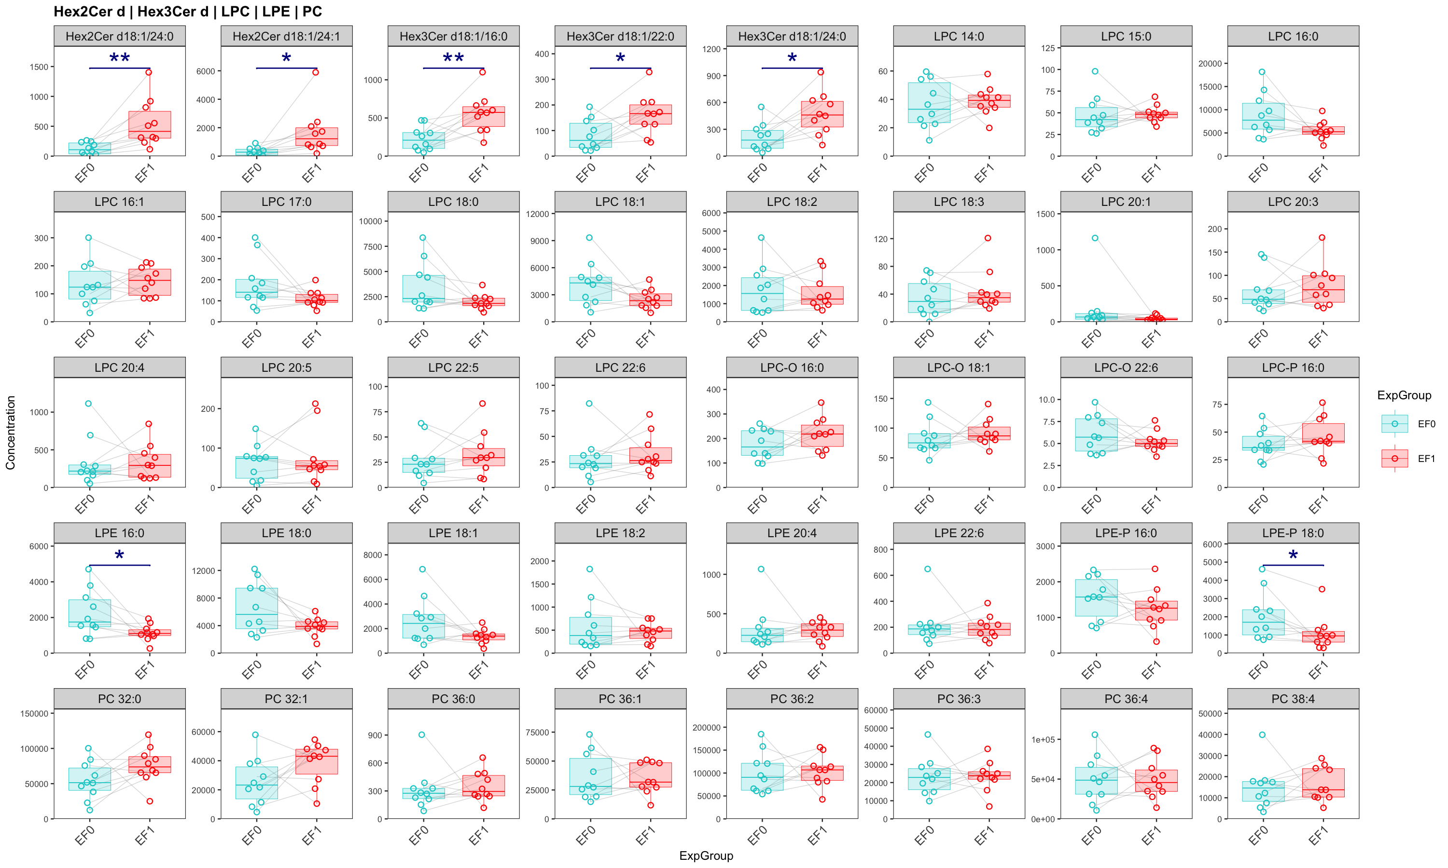
## ## [[3]]

Slide 11
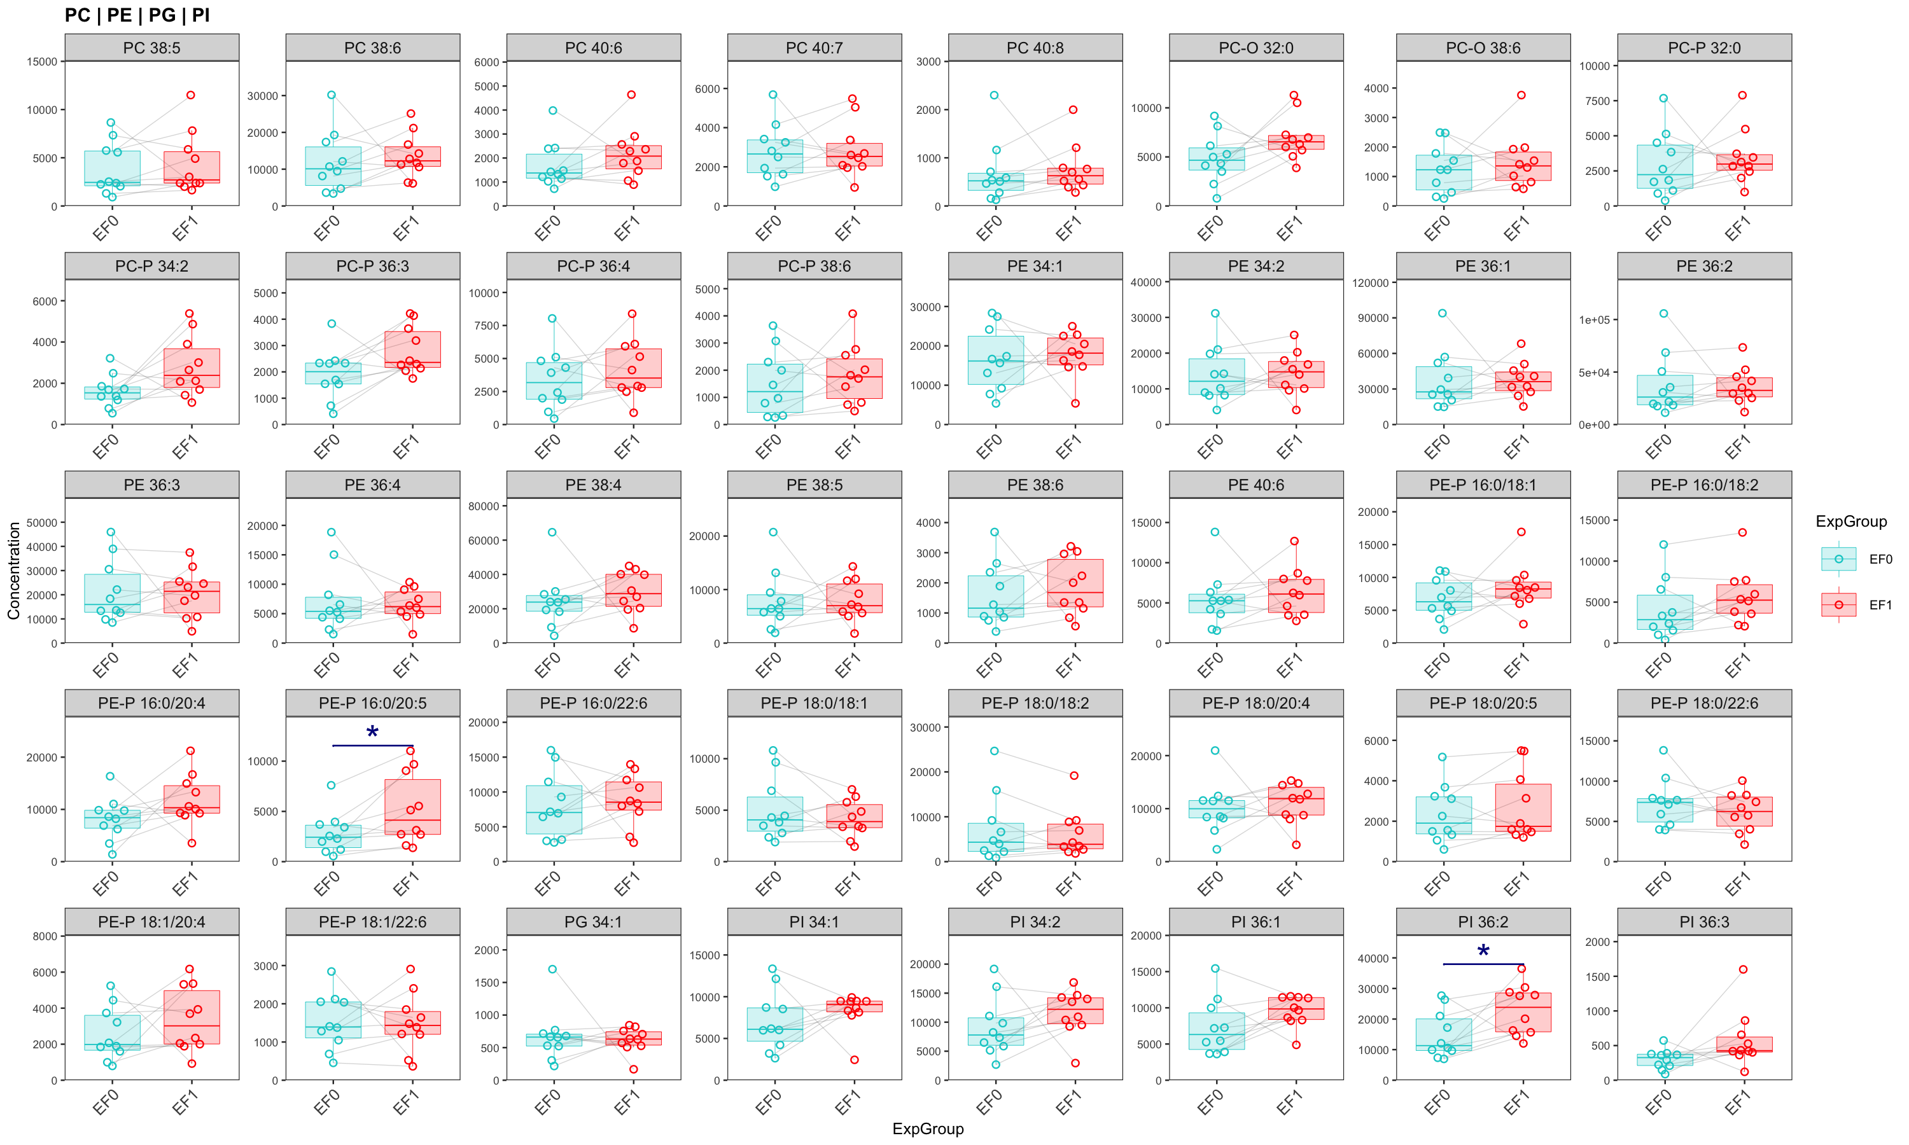
## ## [[4]]

Slide 12
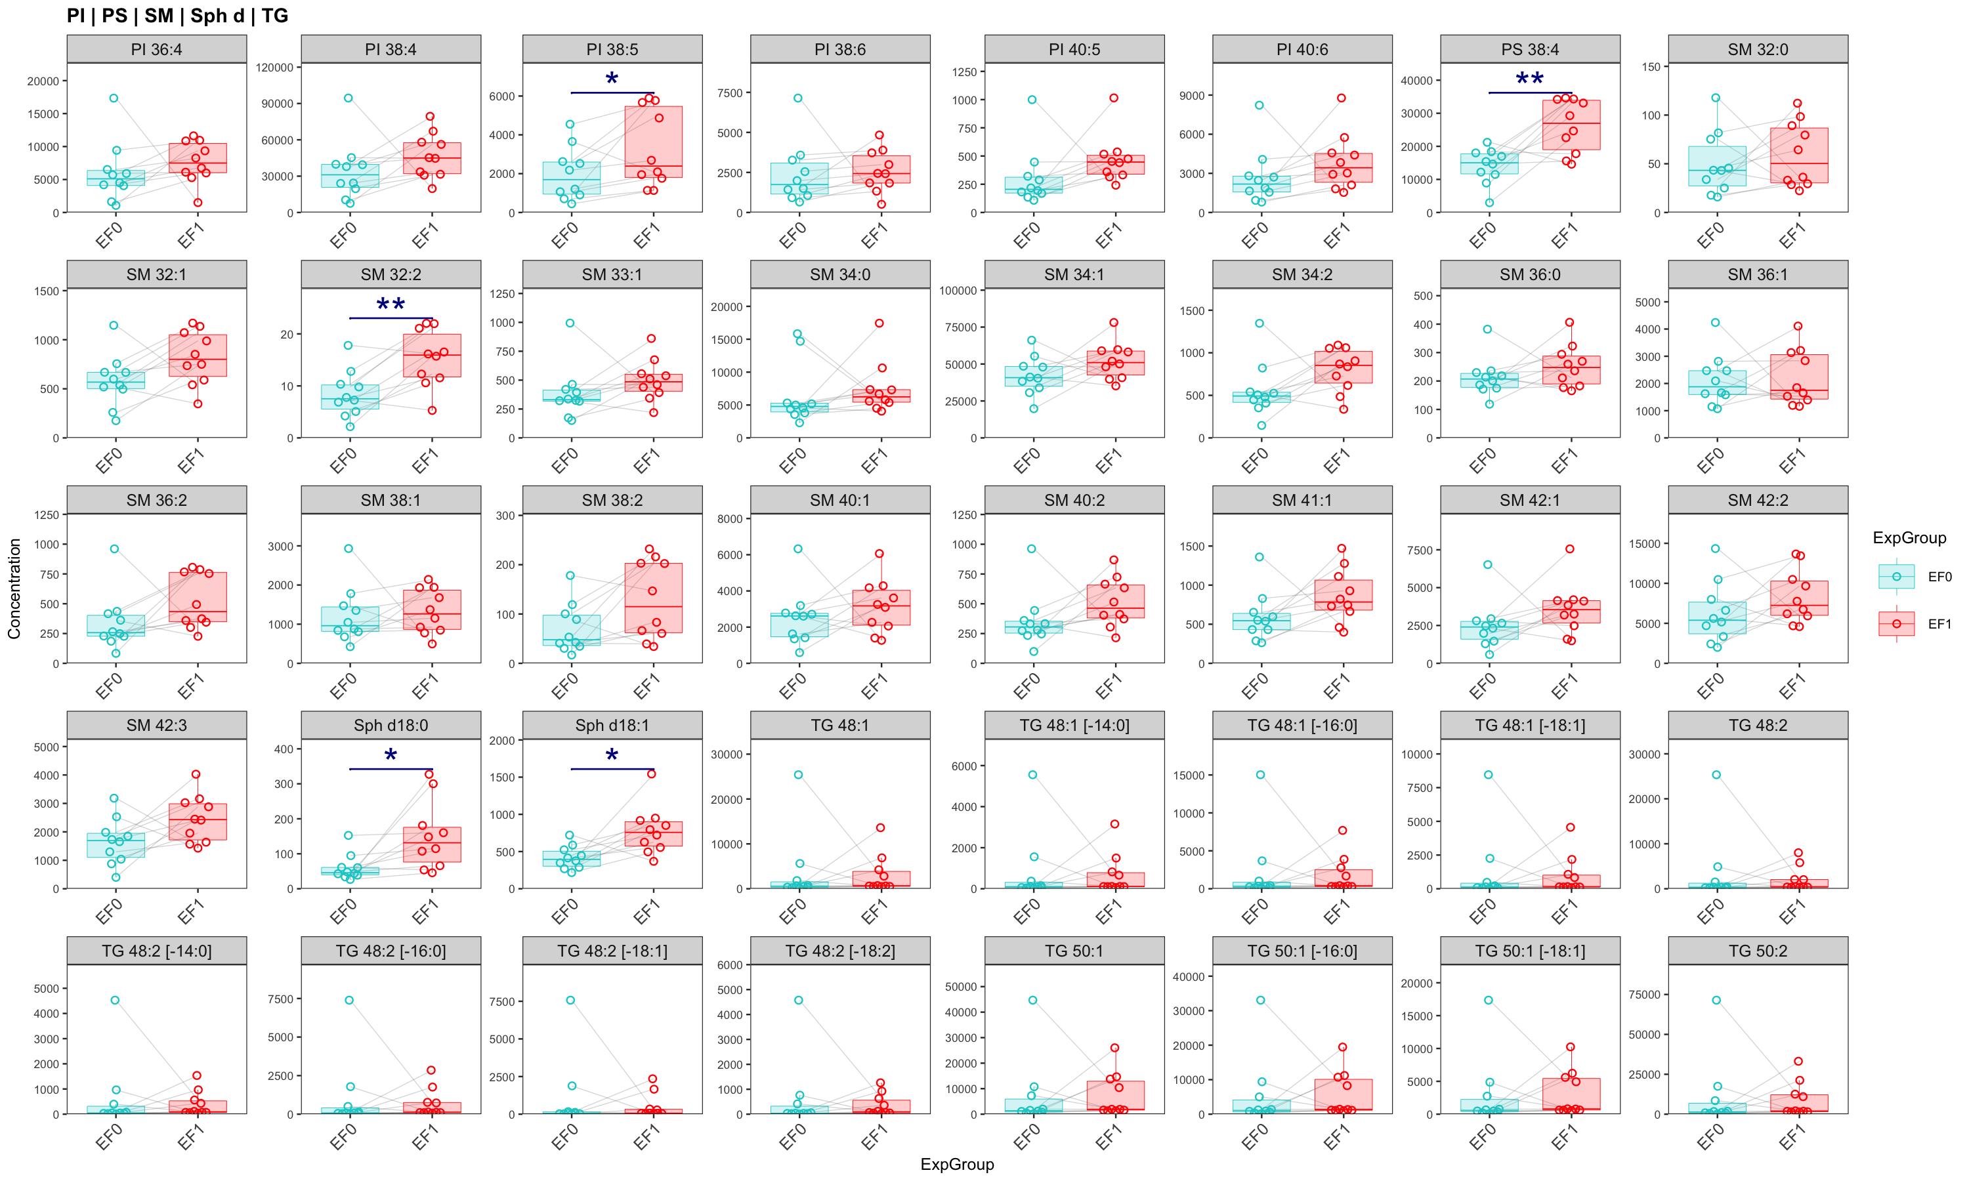
## ## [[5]]

Slide 13
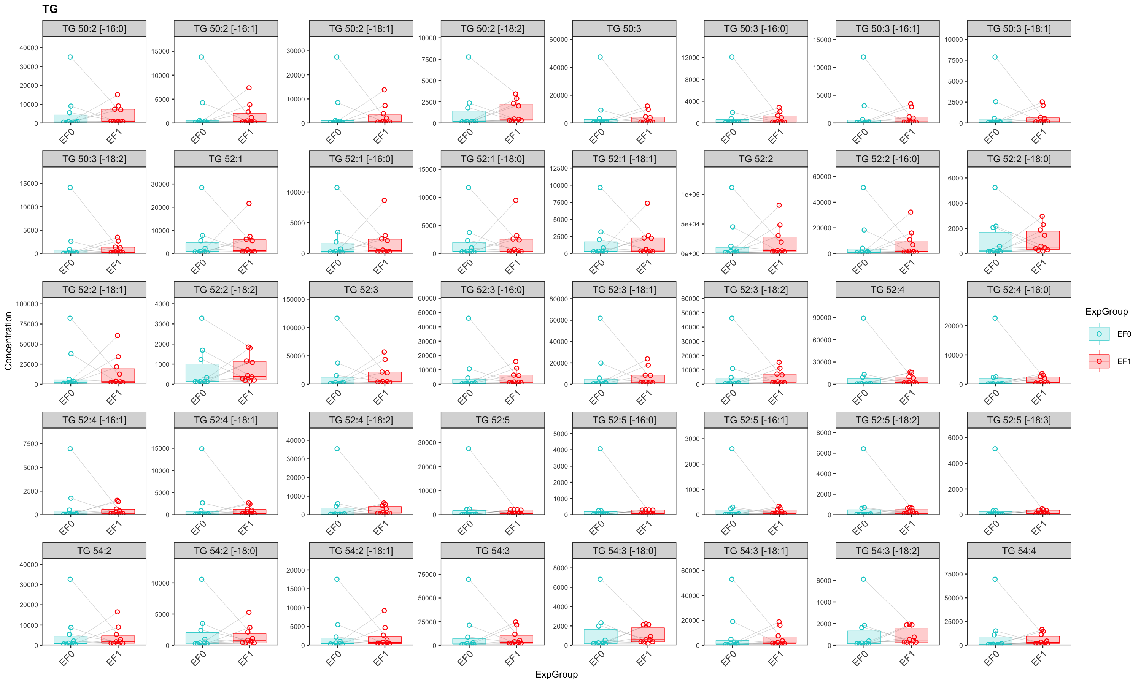
## ## [[6]]

Slide 14
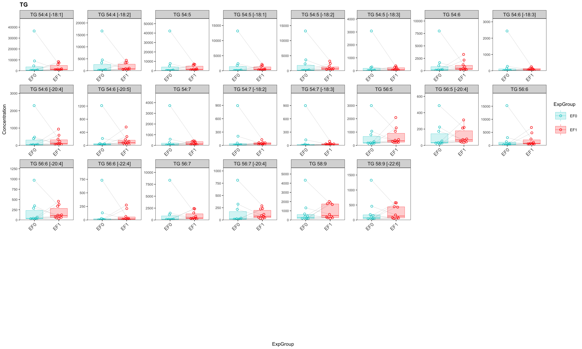
## ## [[7]]

